Slide 1
Java Lecture 12

Slide 2
Package
It is collection of classes and intefaces
Types :
  Pre defined: Java API
  User defined
To call classes or interface from a package “import” is used.
Eg: import package.*;//import all class from specified package
import package.ClassName;//import specified class from the package
Package always use lower case

Slide 3
Java API
There are five basic Java packages:
java.lang Classes that are part of the basic language (e.g. Strings)
java.io Classes that do input and output
java.net Classes for networking
java.awt Classes for creating Graphical Interfaces
java.util General Utility Classes

Slide 4
User defined package
With the help of examples

Slide 5
Applet
awt(abstract window toolkit):
  It is the package that contains classes and interfaces for creating GUI Application in Java
GUI application types:
  Applet
  Application
Applets are small program written in java executed in web browser.
Application are programs written in java executed on Desktop

Slide 6
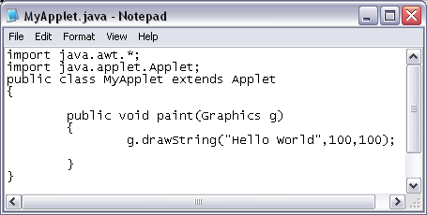
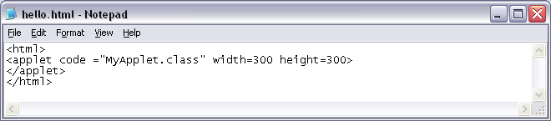
Applet
Steps to create and
execute applet:
Open notepad type program:
Save it: MyApplet.java
Compile it
Create an html file:
Save it: Any name.HTML
Open HTML file in browser.

Slide 7
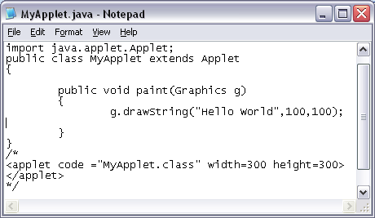
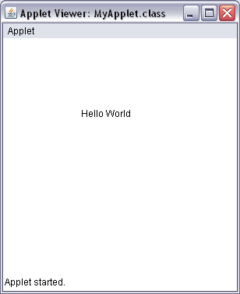

Applet
For testing applet without creating HTML file:

Slide 8
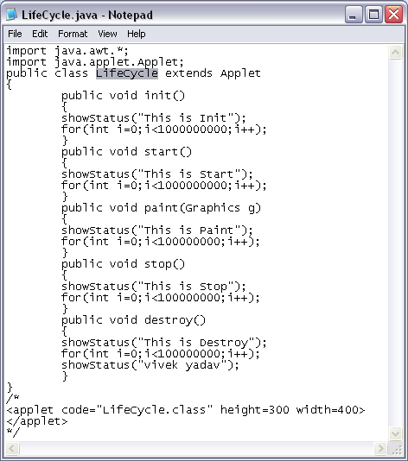
Applet
Life Cycle of applet:

Slide 9
Graphics Class
This class comes from java.awt package
This class contains methods for drawing text , shapes and images in applet
The argument of graphics class is received as an argument in paint.

Slide 10
Graphics Class
Methods to draw shape, line, text & image:
void drawString(String message, int x, int y)
void drawLine(int startX, int startY, int endX, int endY)
void drawRect(int top, int left, int width, int height)
void fillRect(int top, int left, int width, int height)
void drawOval(int top, int left, int width, int height)
void fillOval(int top, int left, int width, int height)
void drawPolygon(int x[], int y[], int numPoints)
void fillPolygon(int x[], int y[], int numPoints)
void drawImage(Image img,int x,int y,<parent>)// parent is this

Slide 11
Font & Graphics Class
Font class:
  This class comes from java.awt package
  Stoes font name .style and size
  Constructor: Font(String name,int style,int size)
  Style can be Font.BOLD,Font.ITALIC,Font.PLAIN
  Eg: Font f=new Font(“Arial”,Font.BOLD+Font.ITALIC,30);
void setFont(font f) //graphics class method
  Specifies the font to be used for drawing text
  Eg: g.setFont(f); Similarly getFont()

Slide 12
Color class & Graphics class
Color class:
  This class comes from java.awt package
  AWT has 16 predefined colors and you can create your own.
  Constructor: Color(int red ,int green ,int blue)
  //range: 0-255
  Color(float r, float g, float b)
  //range:0.0f to 1.0f
  Eg: Color c=new Color(255,255,0)
  Color c1=new Color(1.0f,1.0f,0f)
  Color c2=Color.yellow

Slide 13
Color class & Graphics class
void setBackground(Color c)
void setForeground(Color c)
  These methods comes from applet class
  Eg: setBackground(Color.yellow);
  setBackground(new Color(255,255,0)
  setForeground(Color.Red)
void setColor(Color c)
  This method comes from graphics class
  Eg; g.setColor(Color.red);
  Similarly getColor()

Slide 14
Drawing Image
Two process:
  Fetch the image:
    Use image class and create its object.
    Image getImage(url directory, String name);
    Url getCodeBase(): this method returns the url of the directory that contains .class file.
    Url getDocumentBase():this method returns the url of the directory that contains .html file
    All above methods comes from Applet class
  Draw the image
    void drawImage(Image img,int x,int y,<window>)
    This method comes from graphics class
    this is used in place of window

Slide 15
Passing Parameter From HTML to applet
To pass parameter from html to applet <param> is used
<param> has 2 attributes:
  name & value
  Eg: <param name =“city” value=“jaipur”>

